Slide 1









PROVISION 29 PITFALLS
10 Risks to 2026 Readiness
Don't let these common mistakes derail your corporate governance transformation.
Insight for GRC, Audit, and Executive Teams
LinkedIn Carousel Presentation

Slide 2











Pitfall 1 - The Timing Trap
The Mistake
Provision 29 Timeline Critical Path
Failing to recognize that effective preparation must conclude in 2025 to collect a full year of reliable assurance evidence throughout 2026.
Preparation Complete
Initial Assessment
Board Declaration
The Risk
Postponing initial assessment until late 2026 creates a major operational and compliance bottleneck. Time is the most critical control.
Key Insight: The complexity of P29 requires early preparation to ensure reliable assurance evidence.
2 / 12

Slide 3




















Pitfall 2 - Control Inflation
Bottom-Up Control Inventory Overload
Over-reliance on "bottom-up" control inventories, leading to an unwieldy "inflation" of low-value controls.
The Problem
The Risk
Control Inflation
Dilutes focus on what truly matters
Burdens assurance teams with excessive testing
Obscures true risk behind mountains of data
Creating hundreds of controls without proper materiality filtering.
3 / 12

Slide 4

















Pitfall 3 - The Governance Gap
The Mistake
The Risk
Relying solely on management to sort controls without clear Board and Audit Committee involvement from the outset.
The complexity of P29 necessitates moving controls management beyond the traditional finance silo and placing it squarely on the board's strategic agenda.
Strategic Agenda
Controls Management
Board & Audit Committee Engagement
Key Insight
Provision 29 requires a shift from traditional financial controls to a broader governance approach.
Board involvement is not optional—it's essential.
4 / 12

Slide 5











Pitfall 4 - Defining Success
The Mistake
Qualitative Approach
Measurable Approach
Postponing the definition of what constitutes "effectiveness" for material controls.
Subjective interpretations
Clear, objective criteria
Team disagreements on criteria
Quantifiable success metrics
The Risk
Vague success metrics
Consensus on completion criteria
Project delays and rework
Streamlined decision making
Projects stall due to disagreements on outcomes. You must move away from qualitative statements to incorporate measurable criteria up front.
Key Insight: Define measurable effectiveness criteria before starting your P29 implementation to avoid project stalls.
5 / 12

Slide 6







Pitfall 5 - The Starting Line
The Mistake
Why Materiality Criteria Matters
If the definition of "material" is undefined or delayed, the entire project loses its anchor.
Establishes clear boundaries for control scope
Provides objective basis for control prioritization
Enables consistent application across functions
The Risk
Supports Board's risk oversight role
Struggling to determine which controls truly matter for the Board Declaration, leading to misdirected effort and scope creep.
Materiality Definition Spectrum
Undefined
Clear Boundaries
Early clarification of materiality criteria prevents scope creep and ensures focused effort on controls that matter most.
6 / 12

Slide 7















Pitfall 6 - Workload Shock
The Mistake
Key Bottlenecks
Underestimating the sustained workload required across multiple functions.
Second-line Testing Teams
Internal Audit Capacity
Expanding Internal Audit capabilities requires strategic planning.
Resource constraints in testing teams can delay control assessments.
Key Insight: The complexity of P29 requires careful resource planning and capacity management.
Cross-functional Coordination
Sustained Workload
P29 requires ongoing effort across multiple functions simultaneously.
IT, Compliance, Operations, and Legal must collaborate effectively.
7 / 12

Slide 8












Pitfall 7 - Cultural Friction
The Mistake
Business Unit Cultural Barriers
Failing to manage the cultural shift required to formalise informal controls and processes.
The Risk
Finance
Operations
Compliance
IT
Cultural Resistance
Operational friction and resistance, particularly when engaging a broad spectrum of typically siloed stakeholders.
Key Insight: Successful P29 implementation requires breaking down silos and fostering a culture of controls.
8 / 12

Slide 9










Pitfall 8 - Tech Debt
The Mistake
Relying on basic tools for the complexity and volume of assurance evidence needed.
Manual Processes
Integrated GRC Platform
Time-consuming data collection
Automated control testing
The Solution
Error-prone manual calculations
Consistent, real-time data
Inconsistent data across spreadsheets
Centralized control framework
Integrated GRC technology platforms are essential for confident board declarations.
Confident board declarations
Unable to meet real-time requirements
Technology Maturity
Technology Maturity
Basic Tools
Legacy Systems
Integrated GRC
Full Automation
The requirement for consistent, real-time data makes manual methods obsolete.
9 / 12

Slide 10


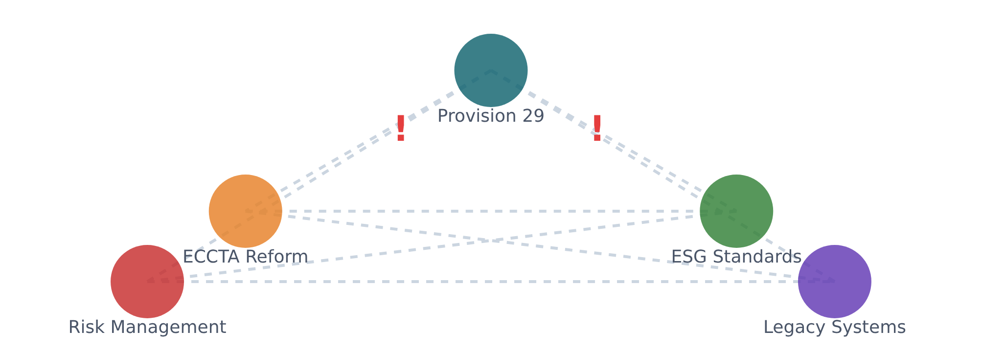











Pitfall 9 - Coordination Headaches
The Mistake
Key Integration Challenges
Failing to coordinate P29 with simultaneous regulatory and operational mandates.
The Risk
Integration challenges create operational bottlenecks and dilute focus on core governance objectives.
Risk Translation
Legacy Systems
Translating risk tolerance into measurable thresholds
Integrating assurance data from legacy systems
ECCTA Reform
ESG Quality
Coordinating with reforms like ECCTA
Achieving "investor-grade" ESG data quality
10 / 12

Slide 11














Pitfall 10 - Missing the Mandate
The Mistake
The Opportunity
Approaching Provision 29 merely as a technical exercise.
This is a strategic mandate for institutionalizing corporate resilience.
Treating P29 as a compliance checklist
Institutionalize corporate resilience
Focusing only on technical requirements
Enhance risk transparency
Missing the strategic governance opportunity
Strengthen foundational governance
This approach undermines the true purpose of Provision 29.
Don't miss the bigger picture.
11 / 12

Slide 12











Are You Prepared for the 2026 Assurance Window?
"A robust control framework is governance, not just compliance."
GRC Technology Role
Audit Committee Alignment
Share Your Insights
Have you clearly defined the role of GRC technology in your organization's Provision 29 implementation?
Is your Audit Committee fully aligned on materiality criteria for Provision 29 assessment?
What has been your biggest hurdle in tackling your internal controls reform? Share your insights below!
Time is of the Essence
Don't let the timing trap derail your corporate governance transformation. Start your Provision 29 preparation today to ensure readiness for the 2026 assurance window.
LinkedIn Carousel Presentation | 12 / 12

